Slide 1
Bike​ ​Sharing​ ​System​ ​ User​ ​Number​ ​Prediction
電子二 r05943011 沈恩禾
電子二 r05943030 吳思儀

Slide 2
Outline
1. Motivation
2. Prior or related work
3. Apporach
4. Results
5. Future work

Slide 3
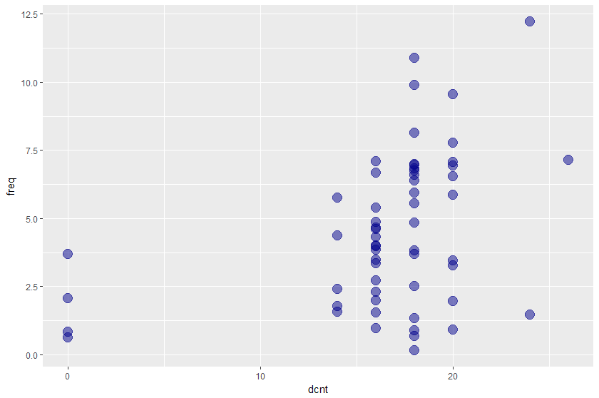
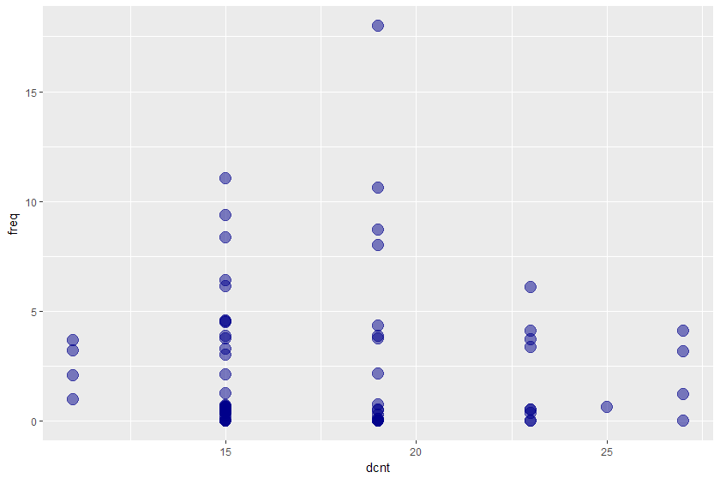
Motivation
Demand of bicycle sharing system has increased
Using user number prediction to achieve the best benefit
Cycle share dataset
SF Bay Area Bike share
Notes:
例如 使用頻率低 但卻有過多車樁
因為圖片比較小
所以在講這張投影片的時候要先講一下橫軸跟縱軸分別代表什麼
然後斜線代表理想的趨勢線（dcnt 和 freq應該要成正比）
可以藉這兩張圖，講一下現有的dataset的站的設置還沒有達到最佳解

Slide 4
Motivation
Demand of bicycle sharing system has increased
Using user number prediction to achieve the best benefit
Considering different factor
population composition (gender/ages)
weather…
Discover inefficiency in cycle sharing system, predict optimal cycle station composition.
Notes:
要考慮設站時, 站的大小
還有每個站彼此之間的距離和設置站點的密度

Slide 5
Related work
臺北市政府交通局:約48%使用者步行時間5分鐘以內，約35%步行時間5-10分鐘，故步行時間10分鐘以內佔八成以上。為能提供可及性更高之服務，以步行距離5分鐘為設站原則，換算其步行距離約為350公尺，故其平均每站服務範圍約在方圓350公尺左右，換算成各站距離約為700公尺
ITDP Bike Share Planning Guide: Minimum System Coverage Area: 10 km2 ; Station Density: 10–16 stations per km2 ; Bikes/Resident: 10–30 bikes for every 1,000 residents (within coverage area) ; Docks per Bike Ratio: 2–2.5 docking spaces for every bike
Ref:[1]http://tcgwww.taipei.gov.tw/ct.asp?xItem=100112484&ctNode=12308&mp=117001
[2]https://www.itdp.org/wp-content/uploads/2014/07/ITDP_Bike_Share_Planning_Guide.pdf
Notes:
https://arxiv.org/pdf/1604.00664.pdf
https://dl.acm.org/citation.cfm?id=2820783.2820837

Slide 6

Approach
Datasets: SF Bay , Cycle Share on kaggle
Preprocess station density, distance matrix, closest station with provided latiutude, longitude information
We define station usage frequency for each months as trip counts related to the station
We group station and weather information into trip information by the start/end station, date of the trip
Notes:
preprocess : using latitude longitude for density, distance , closest distance
usage frequency definition:
weather information selection
58 , 70 station , 200k 700k trips counts
goal of Cycle Share:
How are bike uses or routes affected by user characteristics, station features, and weather?
goal of SF Bay
How does weather impact bike trips?
How do bike trip patterns vary by time of day and the day of the week?
因為想看天氣等資訊如何影響 bike trip（station usage frequency）
所以選用上述的dataset
可能稍微講解一下
dataset原本有哪些atrrtiube, 然後再講說preprocess station後出現了哪些 講解我們是怎麼定義 usage frequency

Slide 7
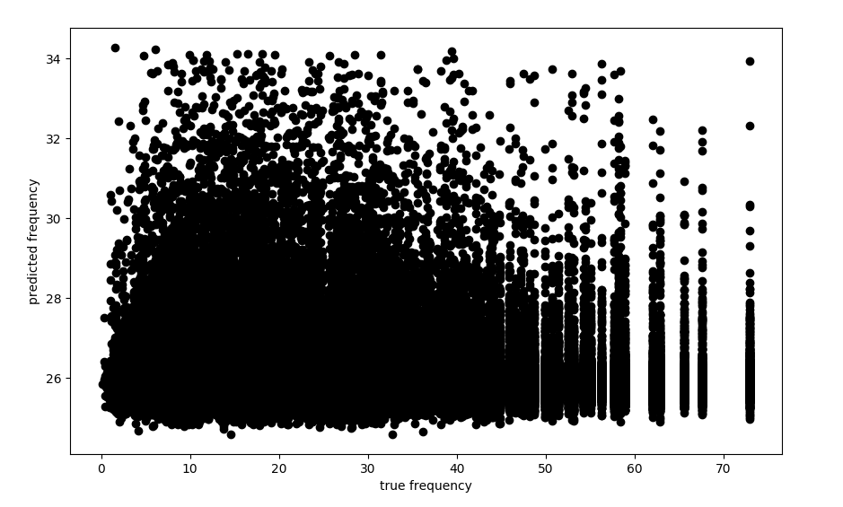
Experiments
given combined trip information, can we predict the station usage frequency (trips/day)?
using library sklearn
LinearRegression
GradientBoostingRegressor
RandomForestRegressor
MLPRegressor
So far the setting of the attributes holds no information to find real usage frequency of related station.
Notes:
需要解釋一下這張圖的x軸跟y軸分別代表什麼

Slide 8
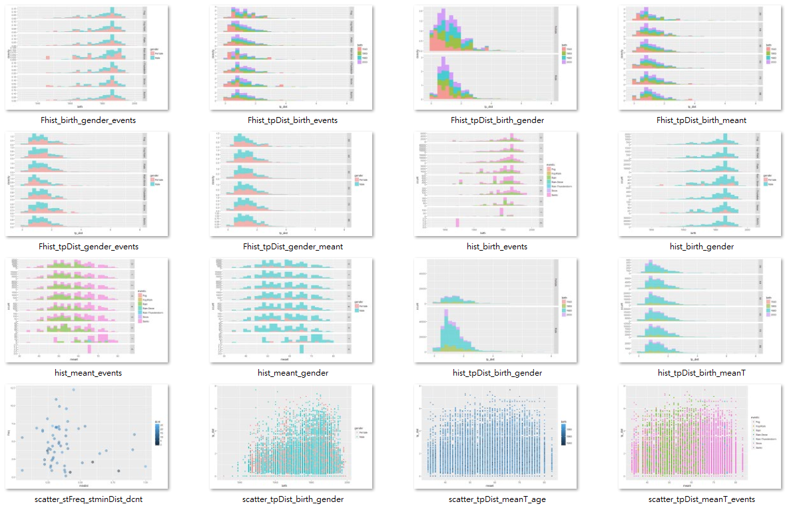
Experiments(cont.)
look further into the data…
most attributes seems independent of the usage frequency
data distributions are mostly identical throughout each stations
we should and will try to use statistical information of trips to predict a station’s usage frequency

Slide 9
Observations
Target value
attributes probability distribution
Notes:
各站各種attributes的分布也許有相對應到使用頻率

Slide 10
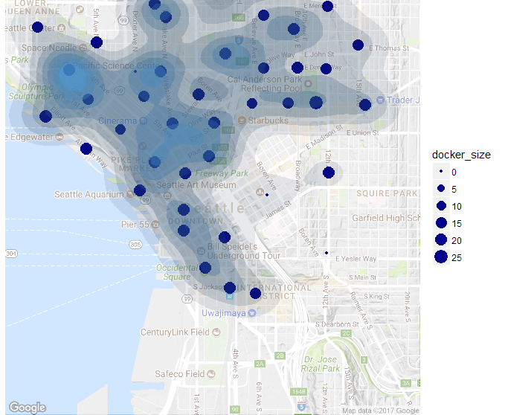
Future work
Intuitively, usage frequency correlates more to its geographcal charcteristic
even so .. sation density, docker size seems not having anything to do with the usage frequency
Statistical trip distribution mapping to station usage frequency
Trip information mapping to trip duration, trip distance
this helps to determine inter-station distance, density etc.
Notes:
密度 站的大小幾乎都沒有直接對應頻率
地理上的因素如周遭設施景點直覺上影響使用頻率較大

